Slide 1
Pet equipment app
Jack Noonan

Slide 2
The what
My project will be based around a mobile application designed around Amazon but specifically catered to people with pets and animals.
Rather than accommodate people with unlimited needs and interests with a huge selection of products and categories, I will be focusing purely on people with pets. With product categories only related to common household pets and horses.

Slide 3
For example, for horse owners they may come to the application in search for new equipment or care products they cant find locally or simply for a wide selection of premium feed for their horses. This will be similar for dog and cat owners wit the addition of toys for the respective pet.

Slide 4
The who
Our application will be completely catered to pet owners and horse owners, regardless of age and gender, who are looking for toys, certain foods for new pet diets and all around pet equipment.
Collars
Bridles
Stirrups
Leads
Etc
Our application will not deviate from this premise to ensure a great application for this group of people while also touching upon a very large potential customer base considering how many people in the world are pet owners.

Slide 5
The why
Although applications such as Amazon provide such a huge and varied choice among products, this backfires in a way that can make finding professional products for specific groups of people especially hard, while also potentially scaring off these customers with the abundance of choice.
Our app will be designed to provide a group of people, pet and horse owners, an amazing shopping experience but with none of the cons talked about above.

Slide 6
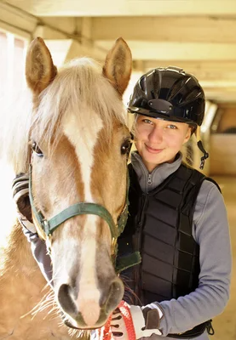
Shirley
Persona
About me: I’m 29 and currently enrolled in college for a bachelors degree and I have been working in my local stables for the past 6 years which I own and keep my horse Cherry who’s 9 years of age.
About my job: My main activities during work include cleaning the yard, washing and grooming the horses plus making sure they are well fed along with my colleagues who share this load to make it more efficient.
Issues: Currently there is no choice for buying horse feed or equipment locally besides one shop which Is close to closing down, contacting businesses over the phone to try get orders through each month is both frustrating and worrying if they will arrive on time.
What I’m looking for: For me the biggest things I’m looking for are a wide but focused selection for horse products and feed but also a very easy means of ordering. A huge plus would be if I was able to subscribe to a product to be delivered each month on selected dates so that I don’t have to worry and get stressed over trying to talk to staff over the phone to get orders through and then waiting and waiting wondering when it will arrive.
Stable hand & horse owner

Slide 7
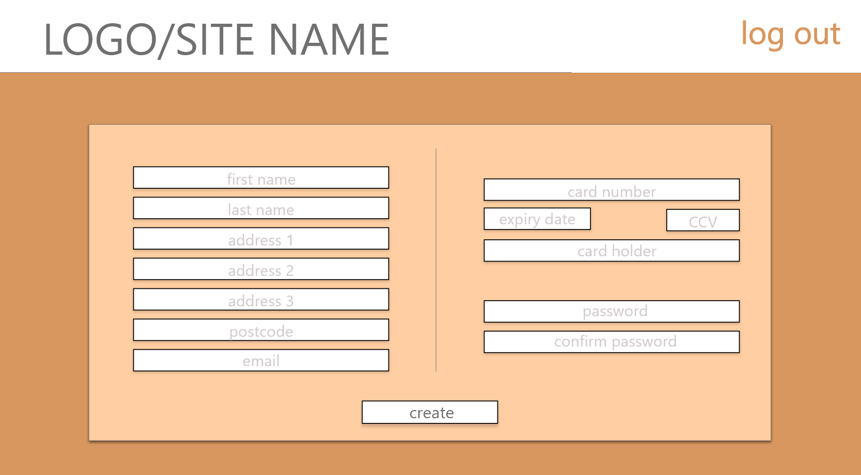

Slide 8
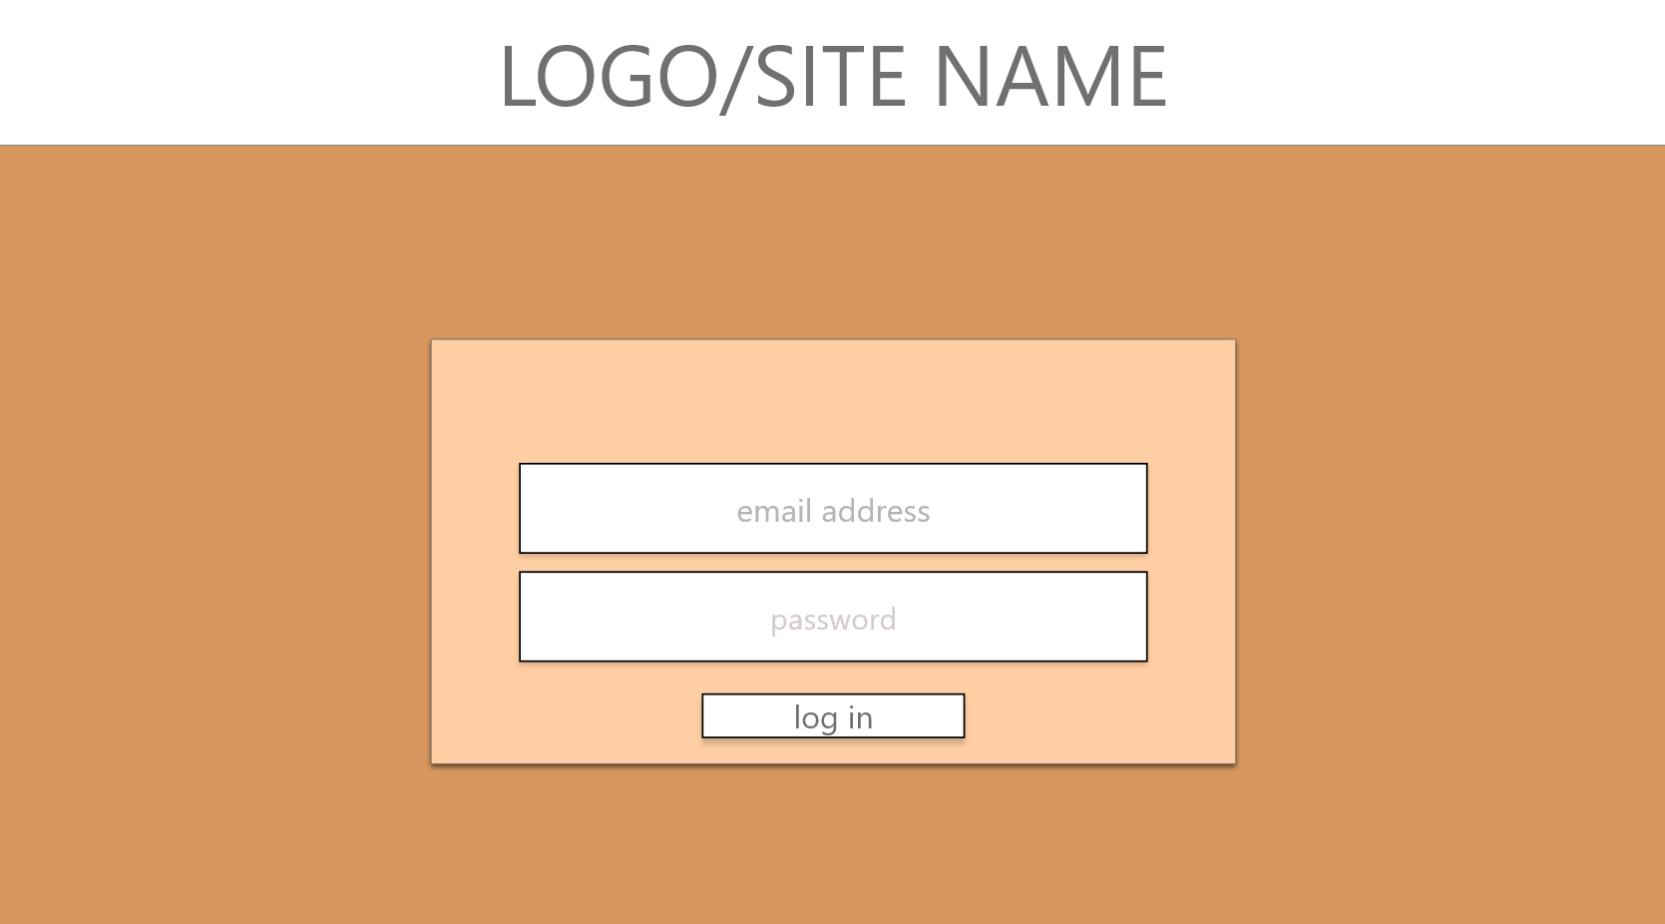

Slide 9
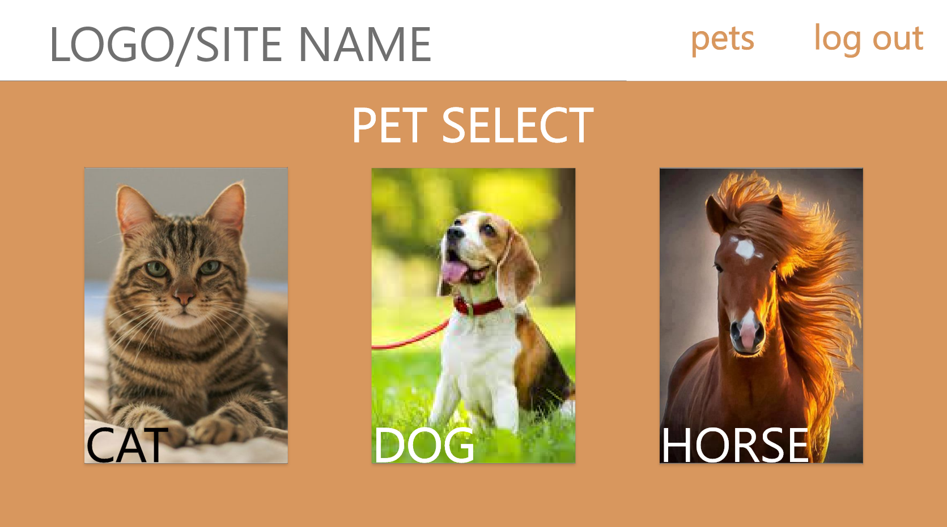

Slide 10
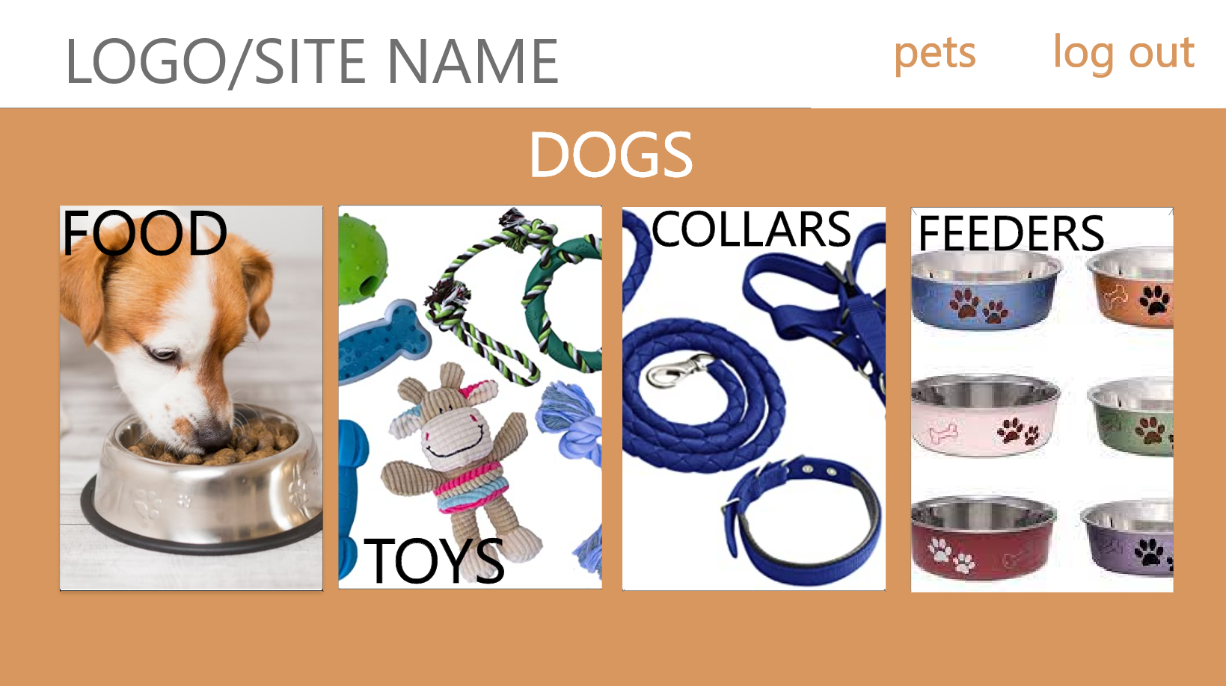

Slide 11
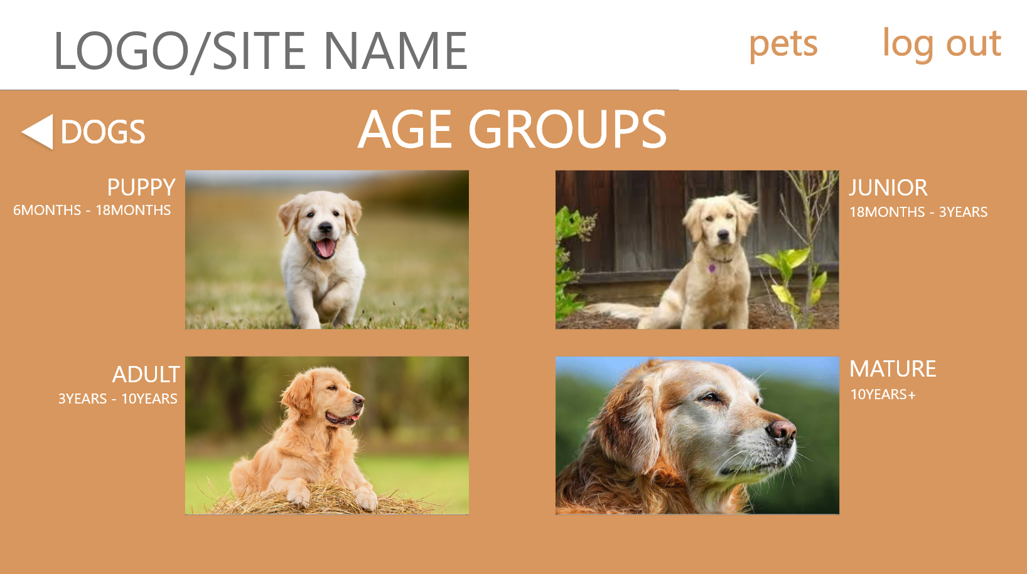

Slide 12
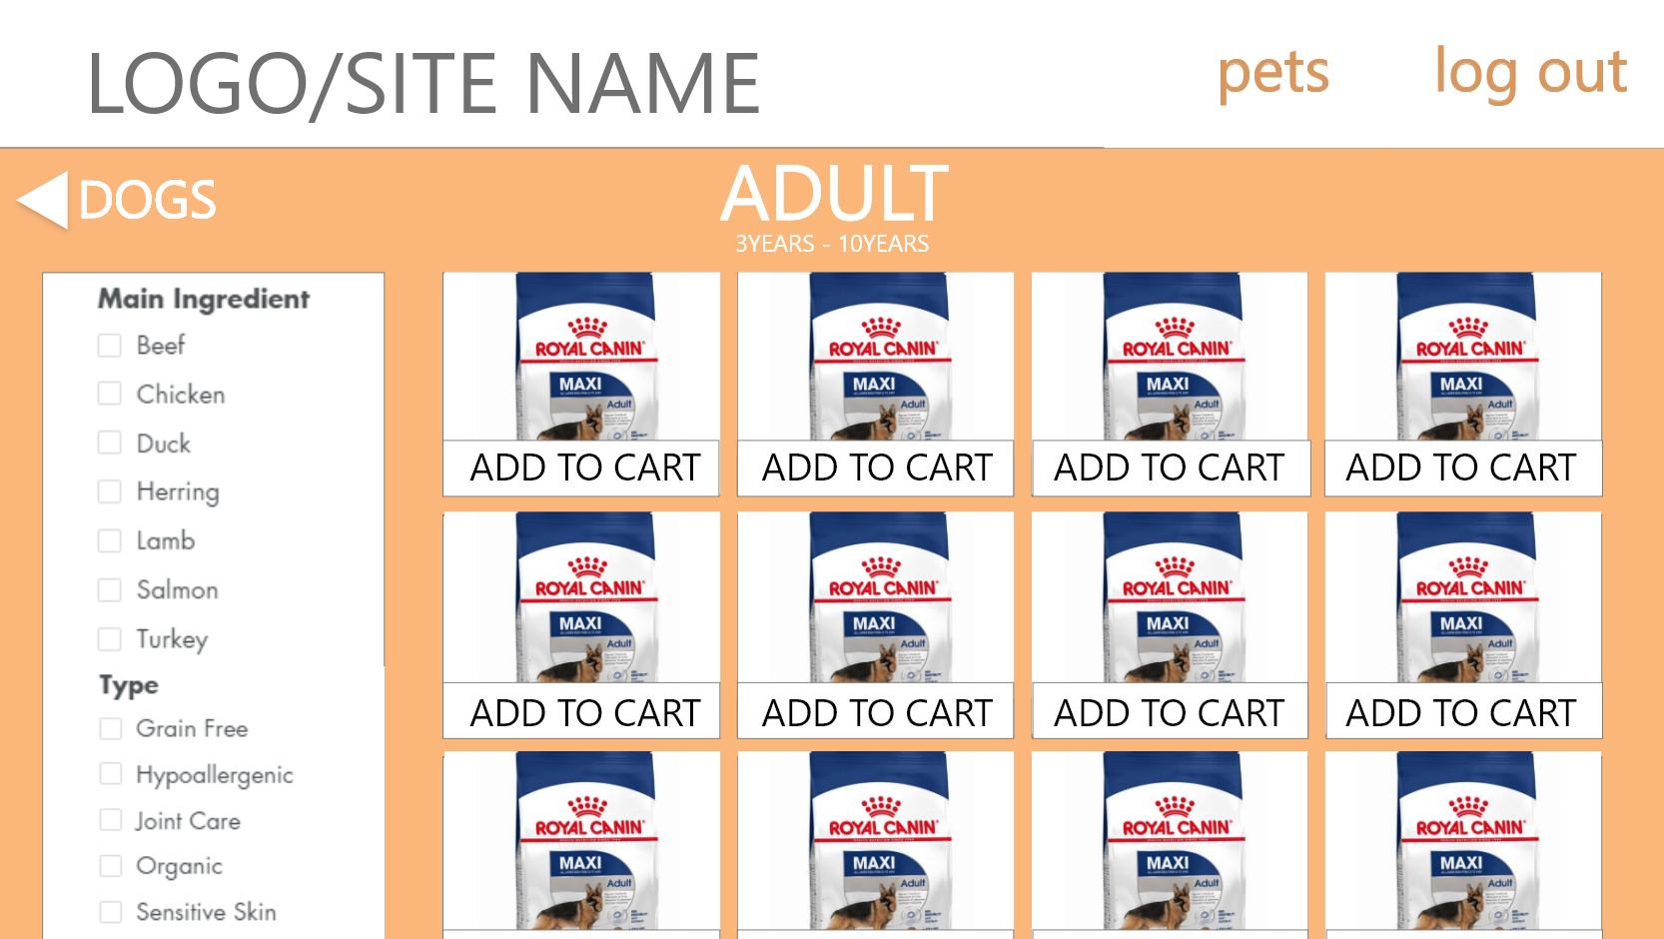

Slide 13
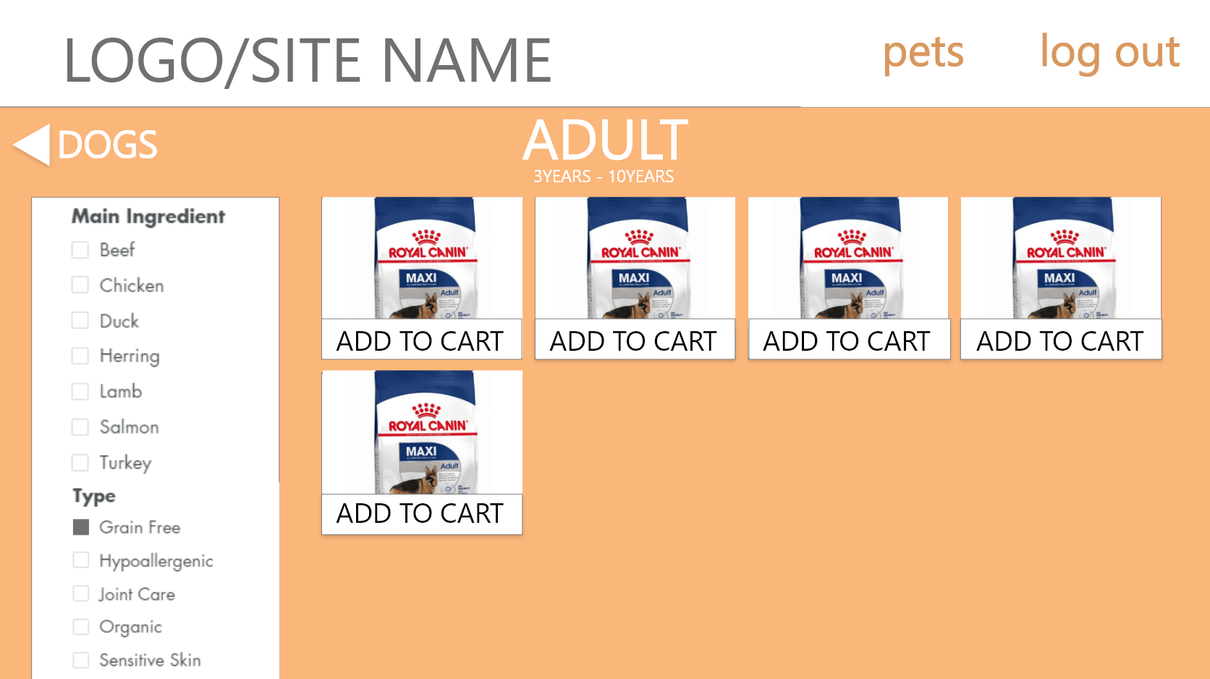

Slide 14
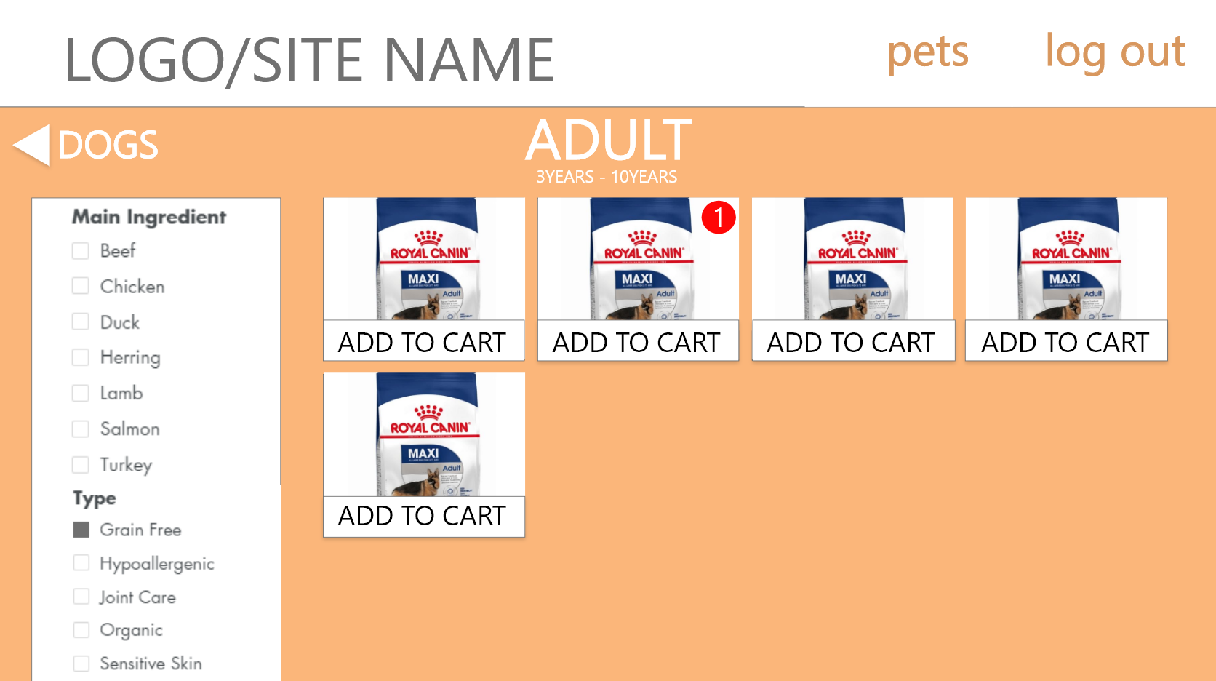

Slide 15
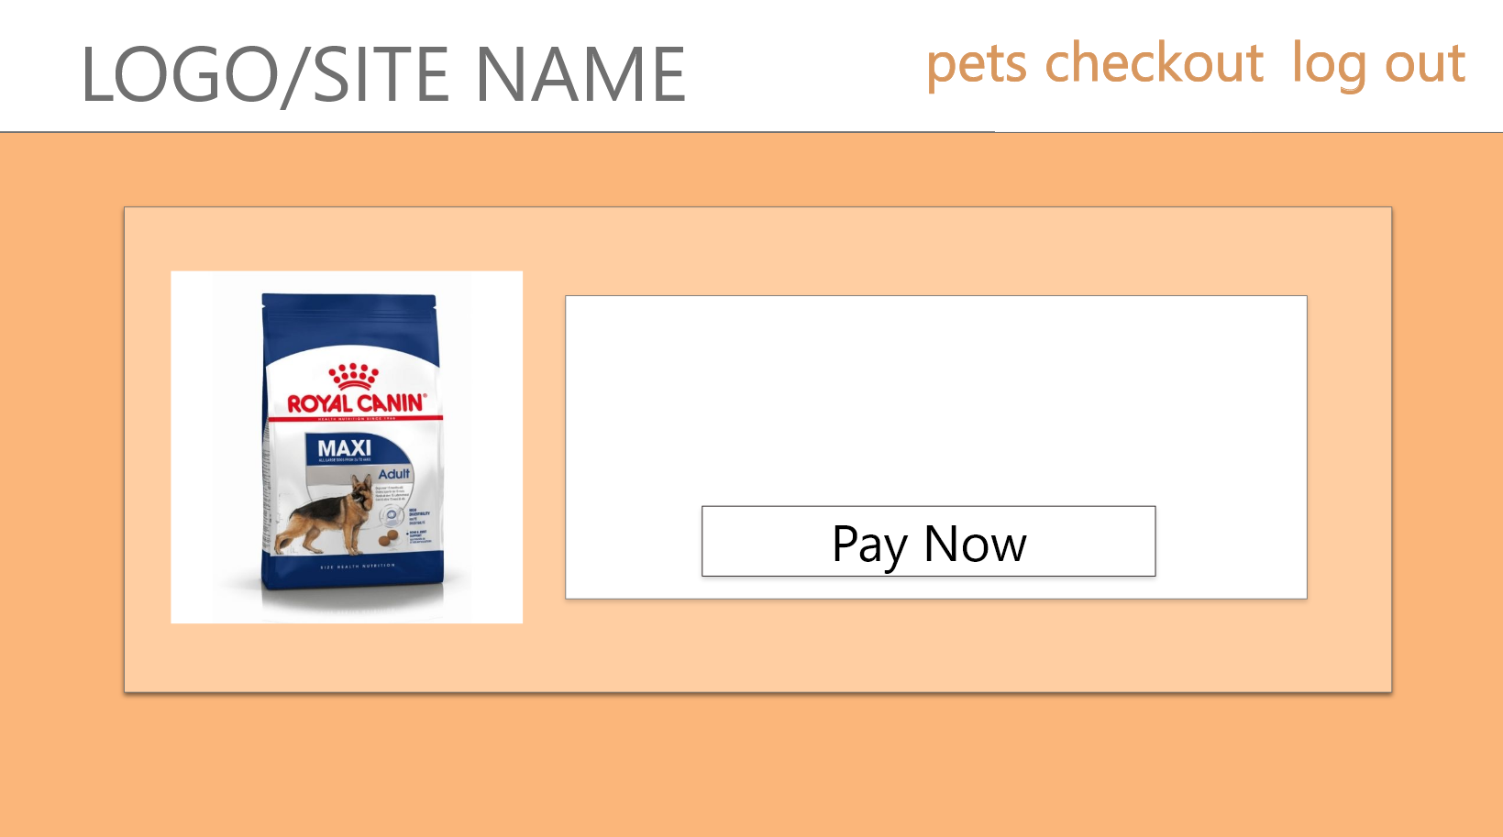

Slide 16
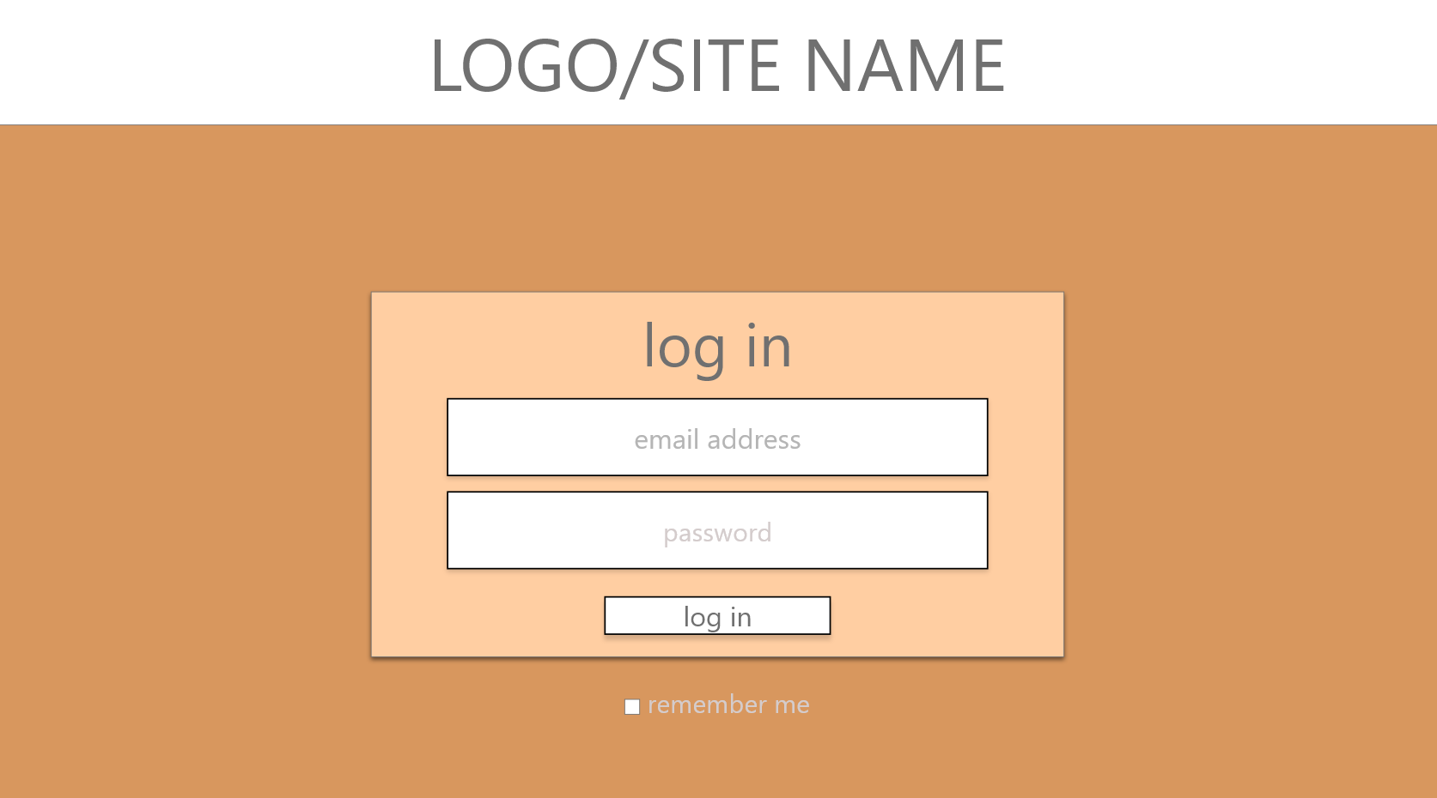

Slide 17
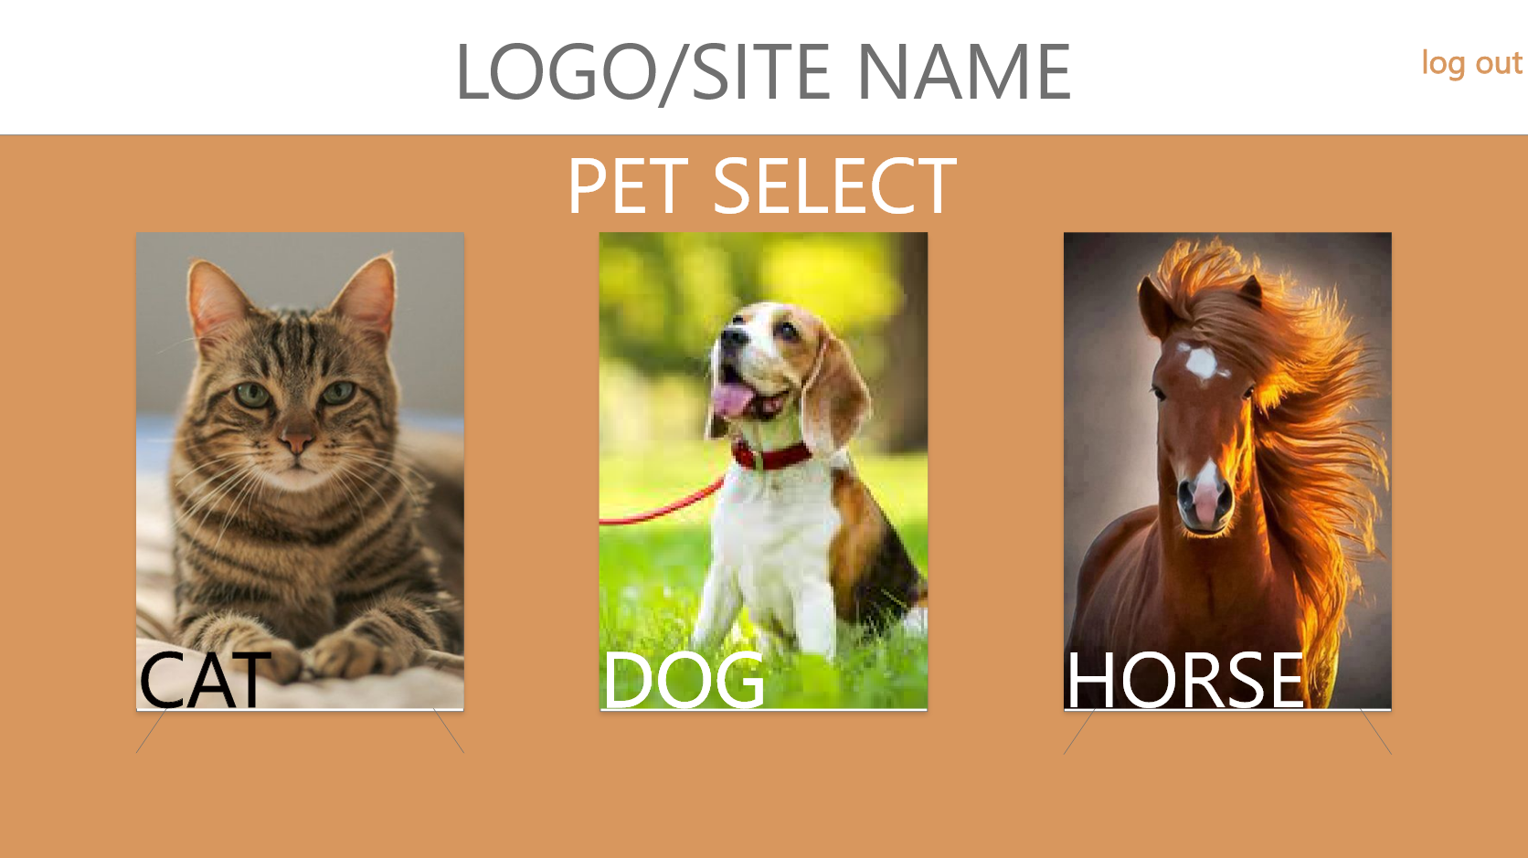

Slide 18
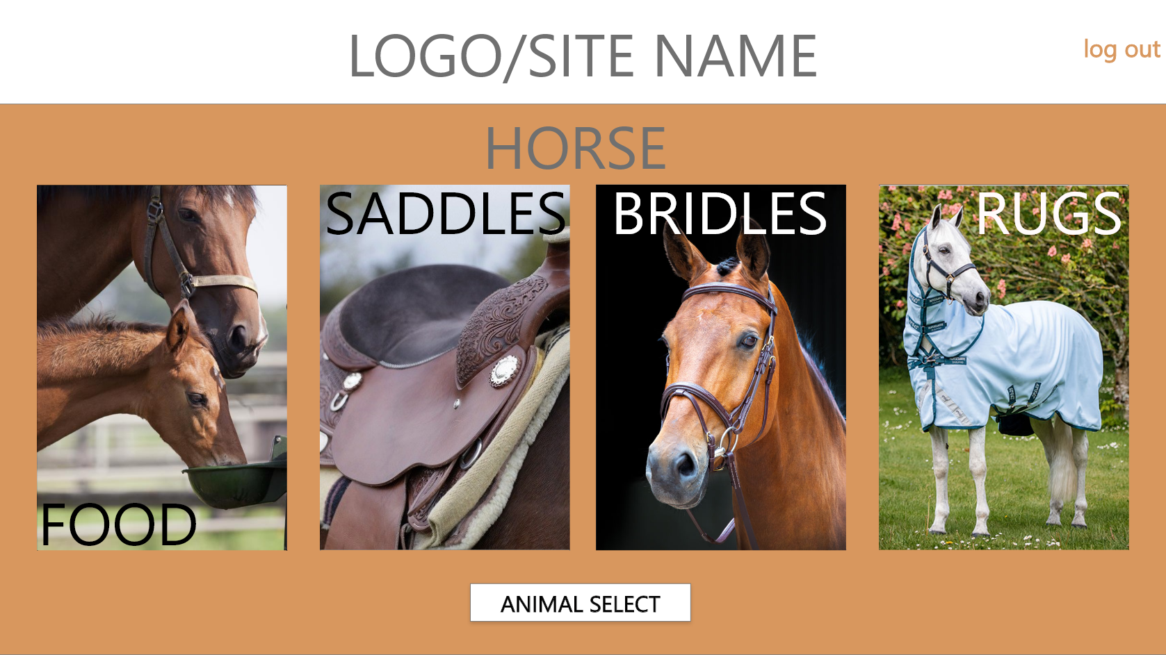

Slide 19
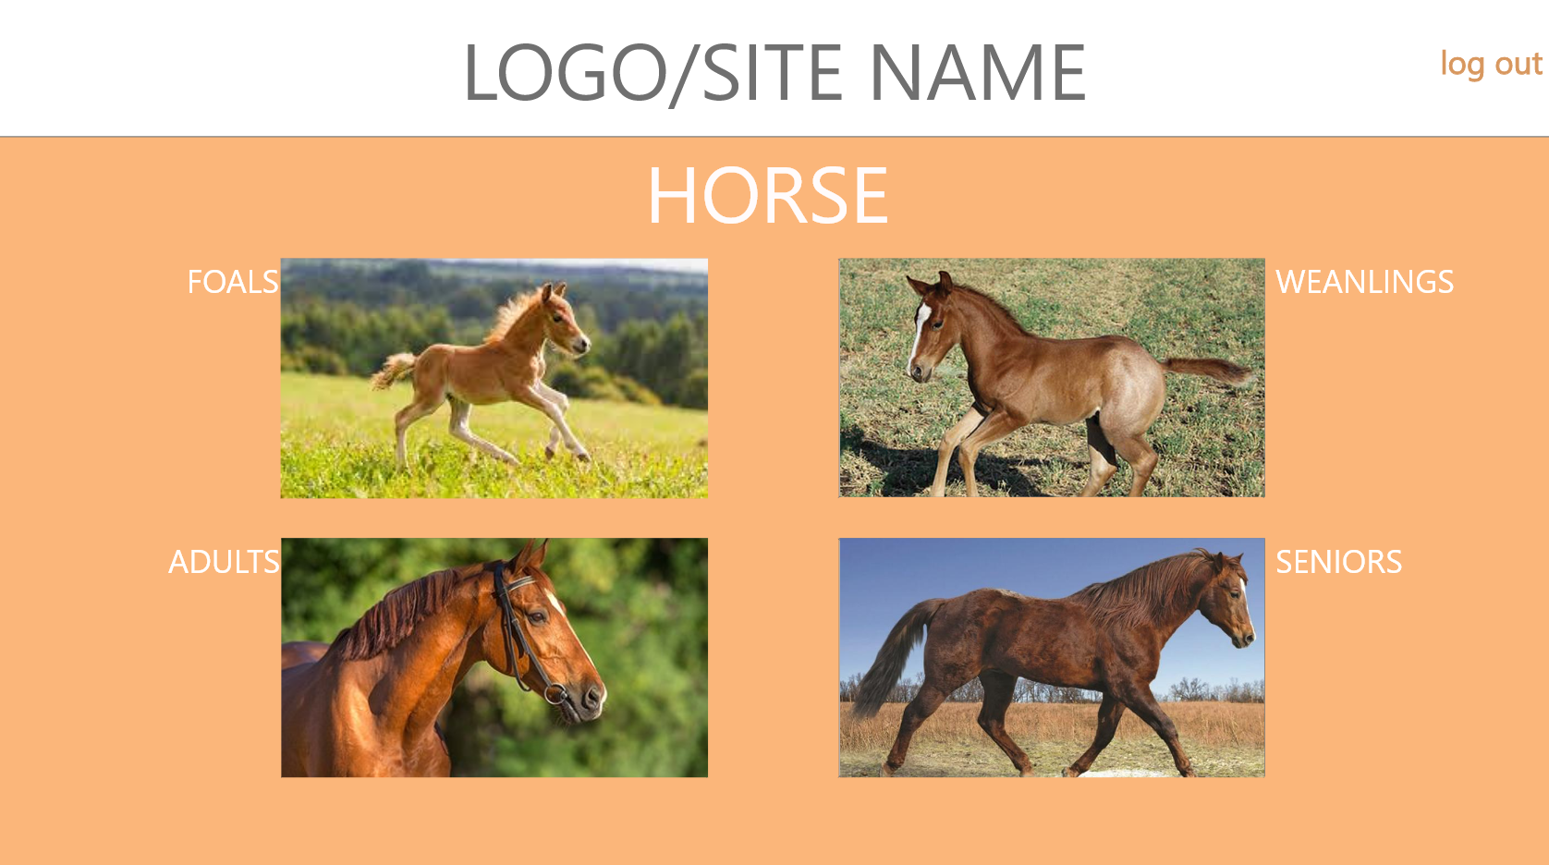

Slide 20
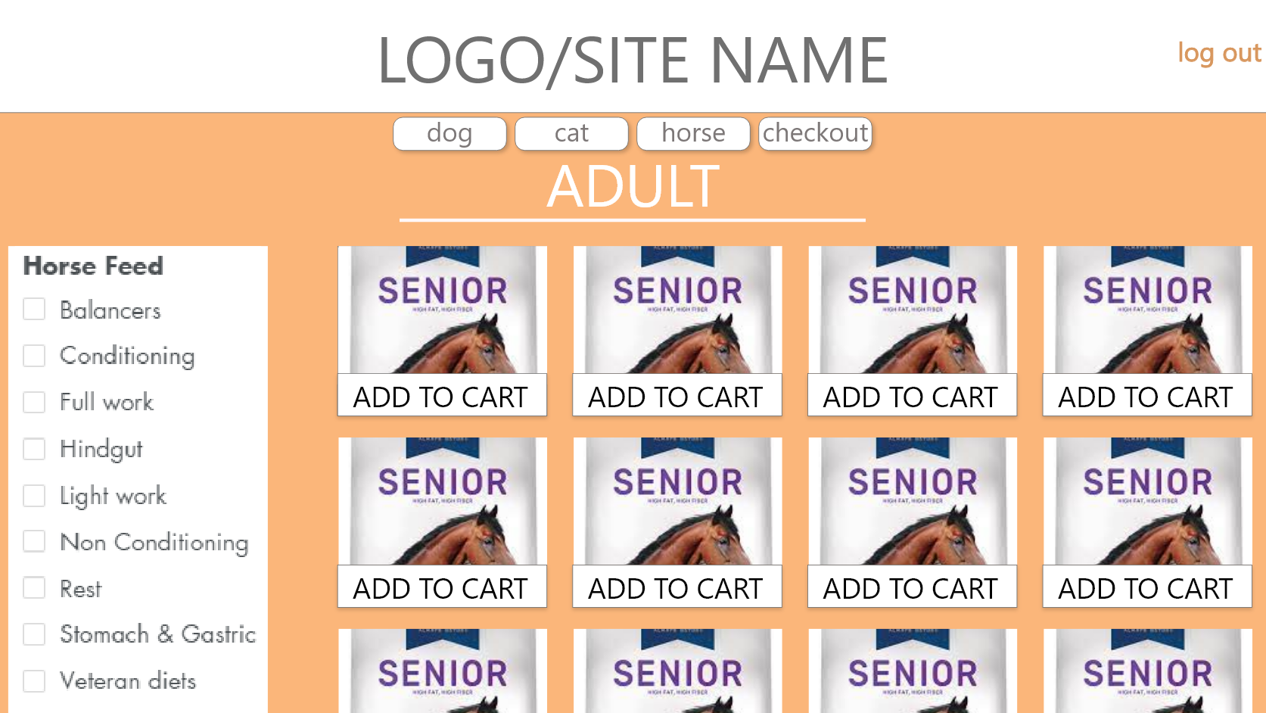

Slide 21
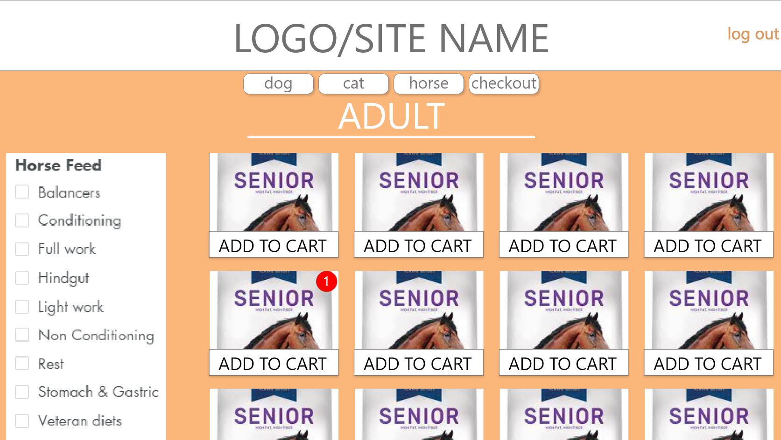

Slide 22
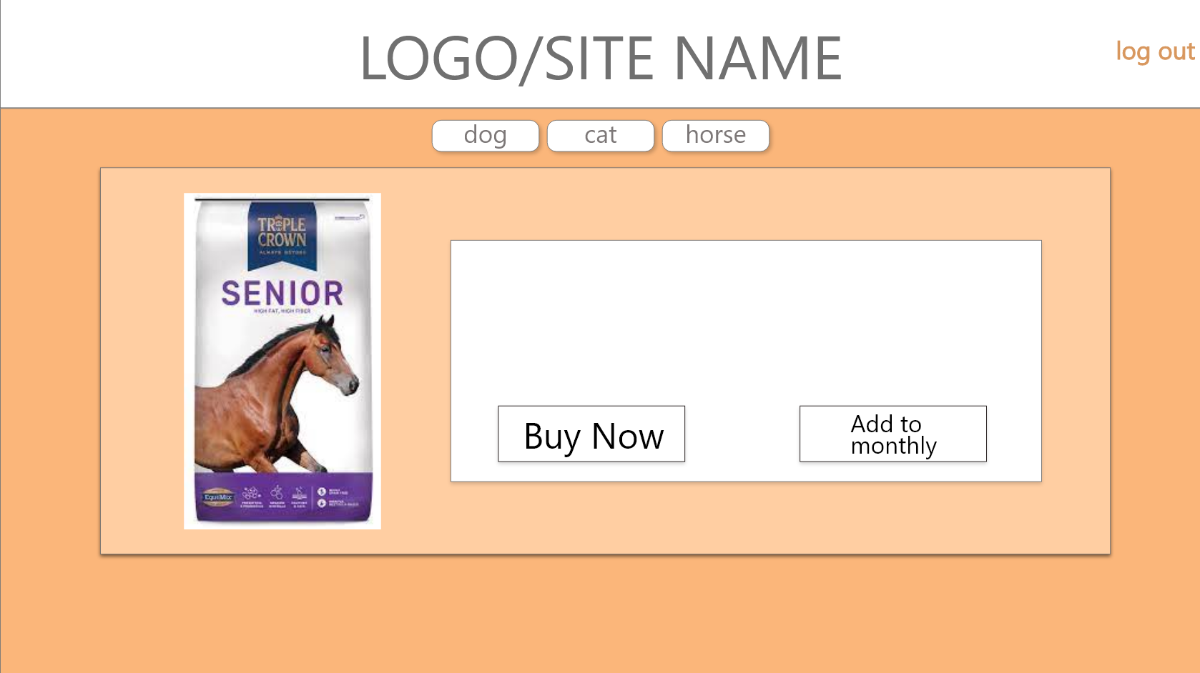

Slide 23
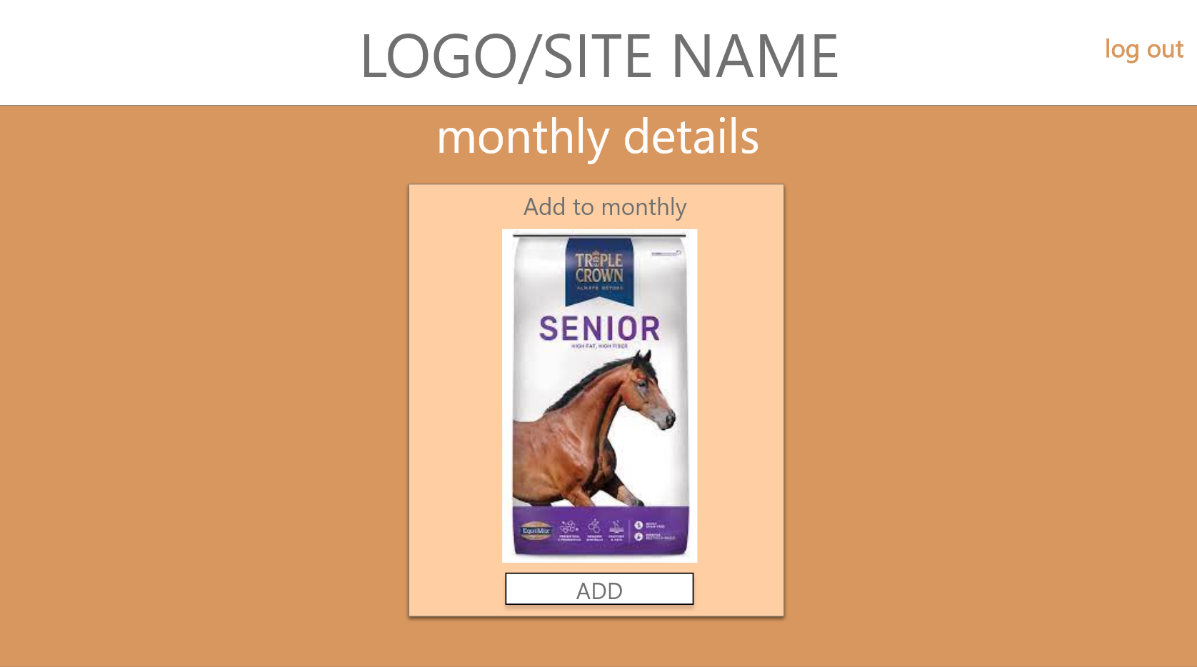

Slide 24
